Slide 1
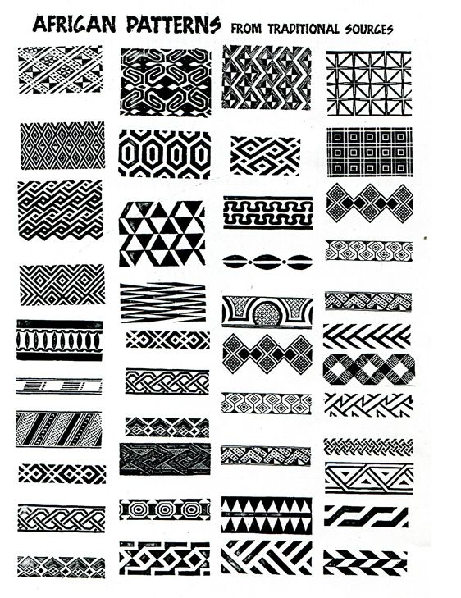
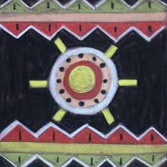
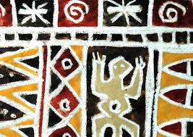
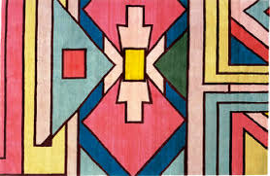
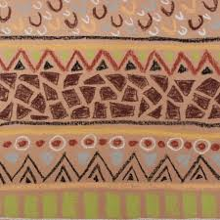
CELEBRATING CULTURE
TASK: Respond to African Patterns and Symbols by creating a Drawing, Painting or Art work inspired from the examples.
INSTRUCTIONS:
1. Look at the examples of Traditional African Patterns and Symbols. Begin by either copying or creating your own outline drawing inspired by the examples.
2. Use Colouring Pencils, Paints or your choice of medium to bring the outline to life. Use your knowledge of layering and blending colours or paint by mixing colours to create a successful outcome.
3. Annotate and Evaluate the Art work you have produced.
Student examples of task

Slide 2
Annotations and Evaluations
Explain you materials and techniques used.
How effective are they? Use the formal elements and quality describing words to explain.
Describe what you have done.
I have responded to African Culture by creating my own Art Work inspired by Traditional Afican Patterns and Symbols .
-How did you create it?
-How have the materials and techniques you used worked well?
-Describe and explain a success
-Describe and explain an unsuccessful part.
The Formal Elements
Tone Colour Texture Shape Form Line
Key Words -
Traditional Layering
Effective Shading
Pattern Symbols
Patchy Smooth
Interesting Accuracy

Slide 3
Examples of Traditional African Patterns and Symbols

Slide 4
Examples of Traditional African Patterns

Slide 5
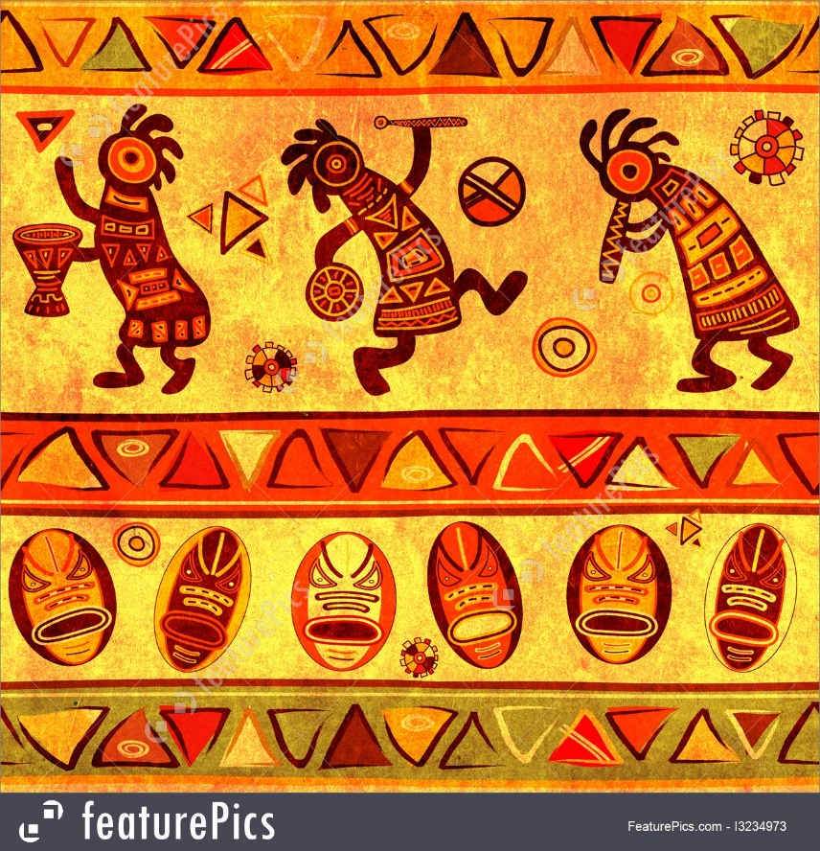
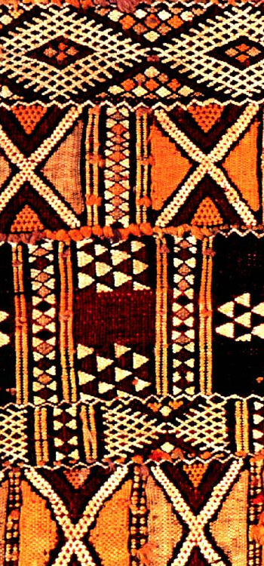
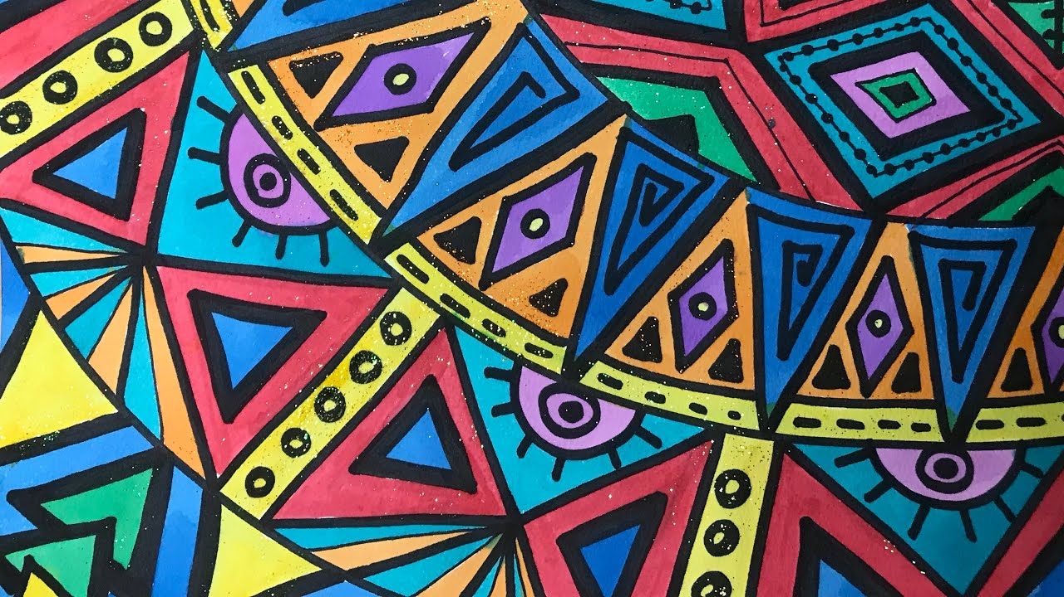
Examples of Traditional
African Patterns

